Slide 1
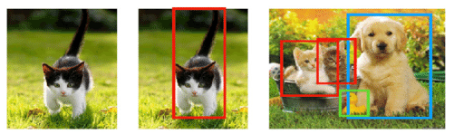
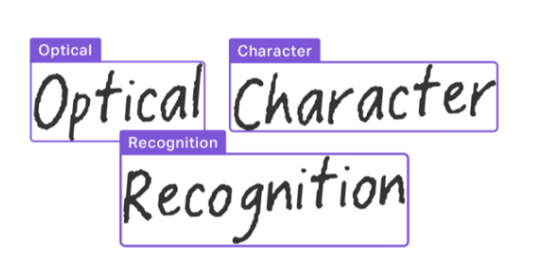
Modeling for Computer Vision
AI VIETNAM
All-in-One Course
TA Hùng An

Slide 2
Nội dung
AI VIETNAM
All-in-One Course
Classification
Object Detection
Optical Character Recognition

Slide 3
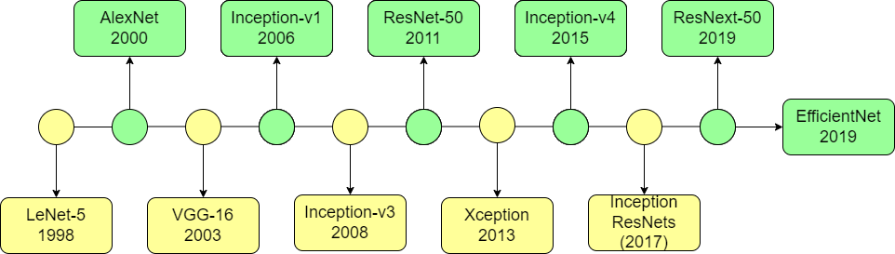
1 - Classification
AI VIETNAM
All-in-One Course

Slide 4

1 - Classification
AI VIETNAM
All-in-One Course
Timm - pytorch-image-models

Slide 5
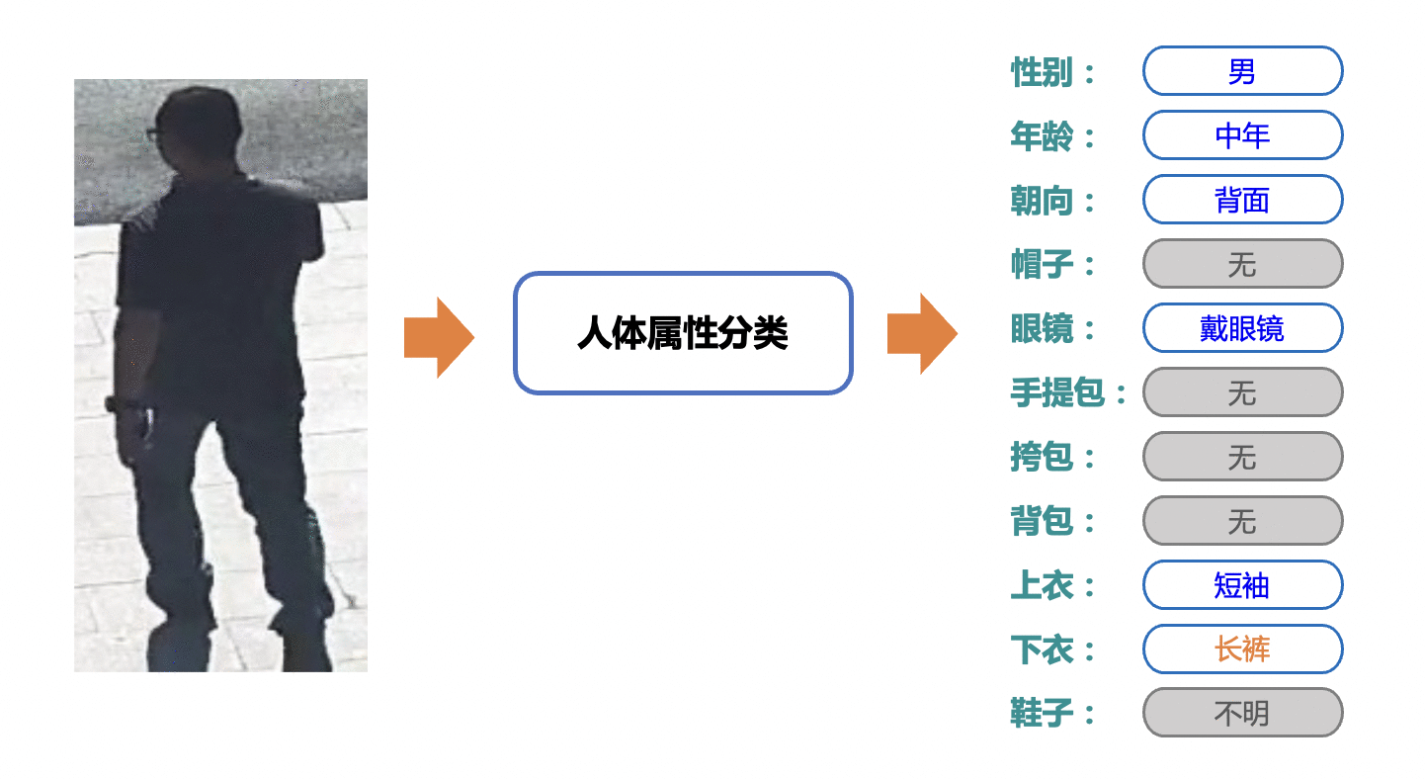
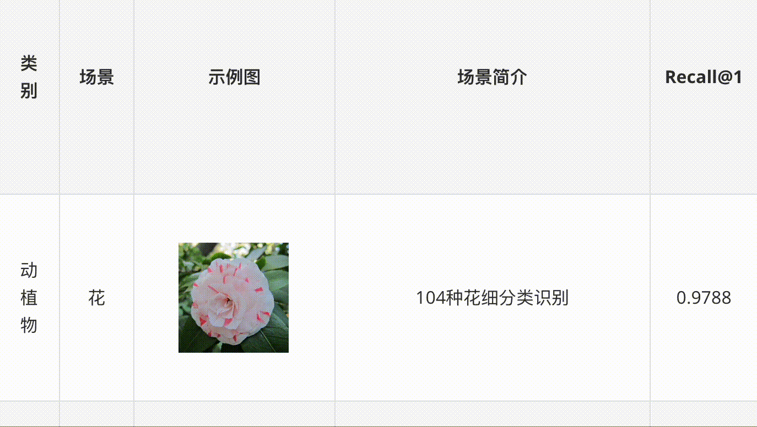

1 - Classification
AI VIETNAM
All-in-One Course
PaddleClas - PaddleClas

Slide 6

1 - Classification
AI VIETNAM
All-in-One Course
mmclassification - mmpretrain

Slide 7
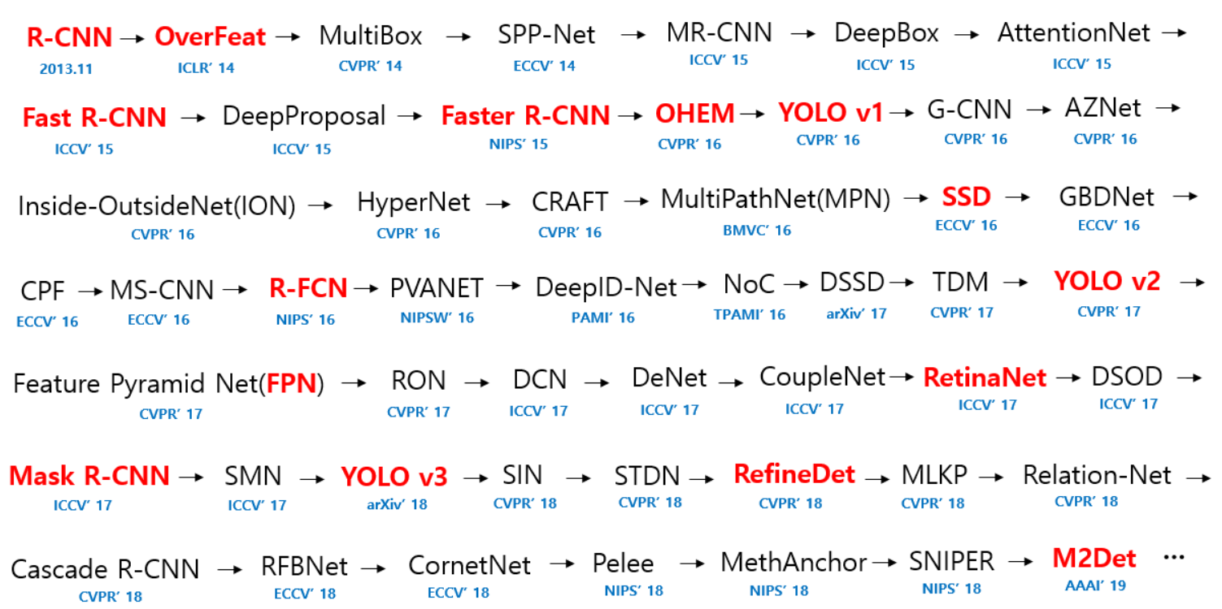
2 - Object Detection
AI VIETNAM
All-in-One Course

Slide 8
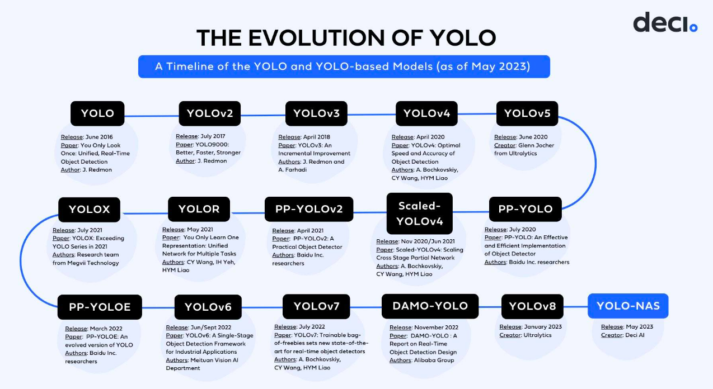
2 - Object Detection
AI VIETNAM
All-in-One Course

Slide 9
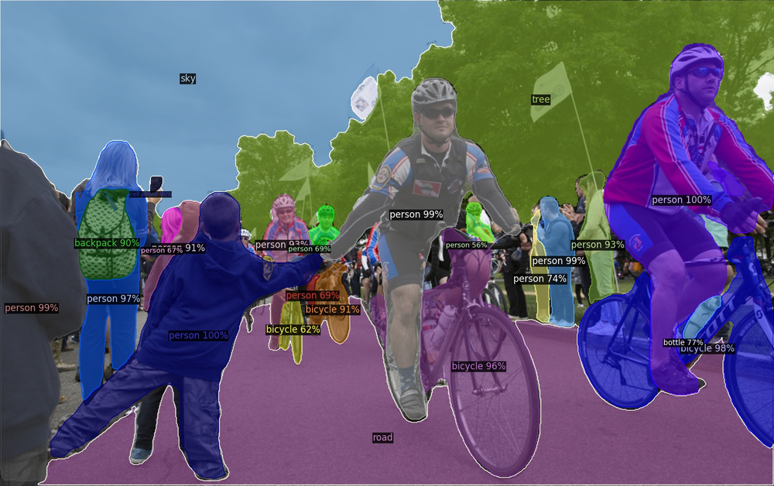
2 - Object Detection
AI VIETNAM
All-in-One Course
detectron2 - detectron2

Slide 10
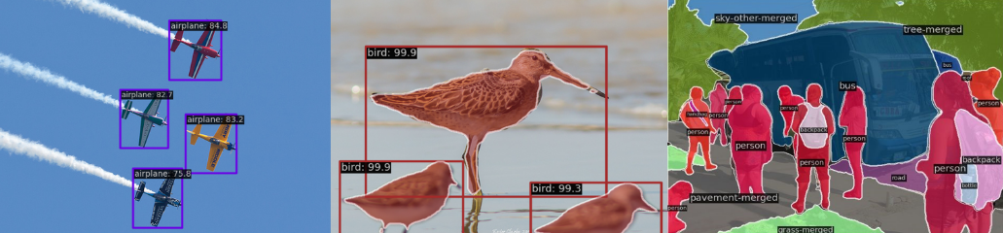
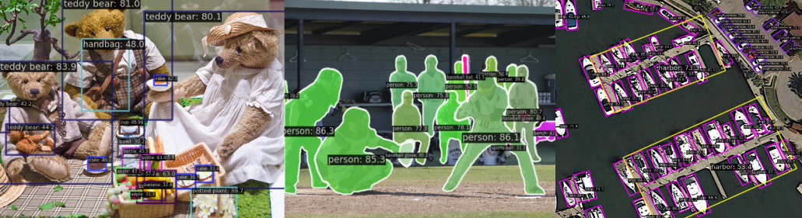
2 - Object Detection
AI VIETNAM
All-in-One Course
mmdetection - mmdetection

Slide 11
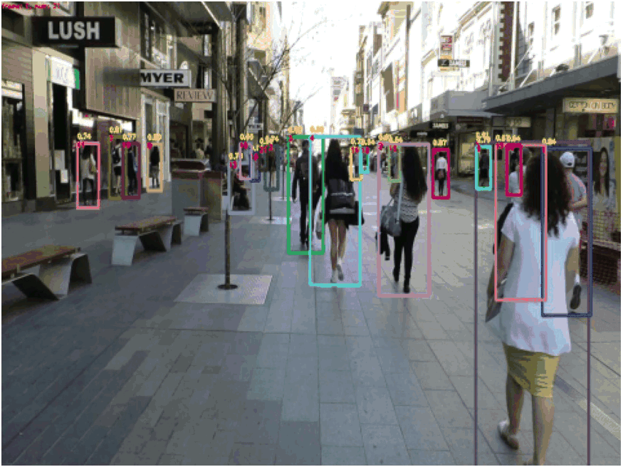
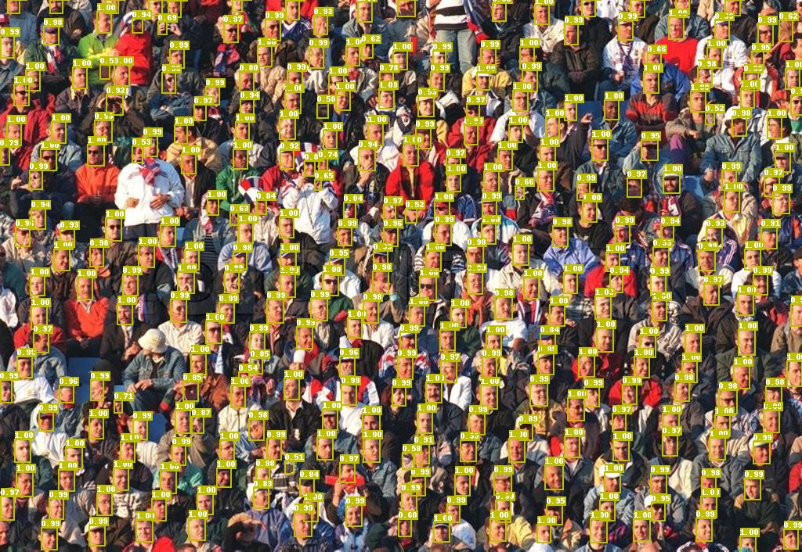
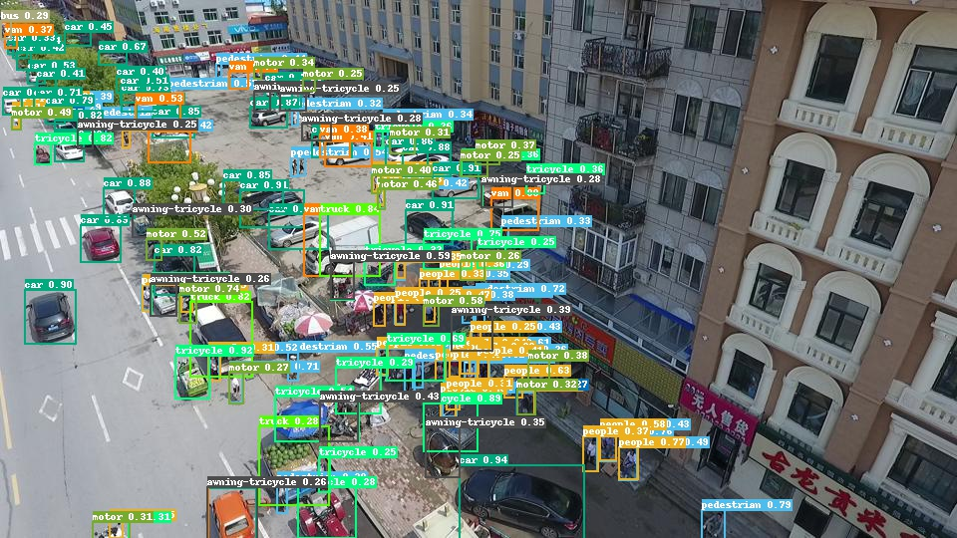
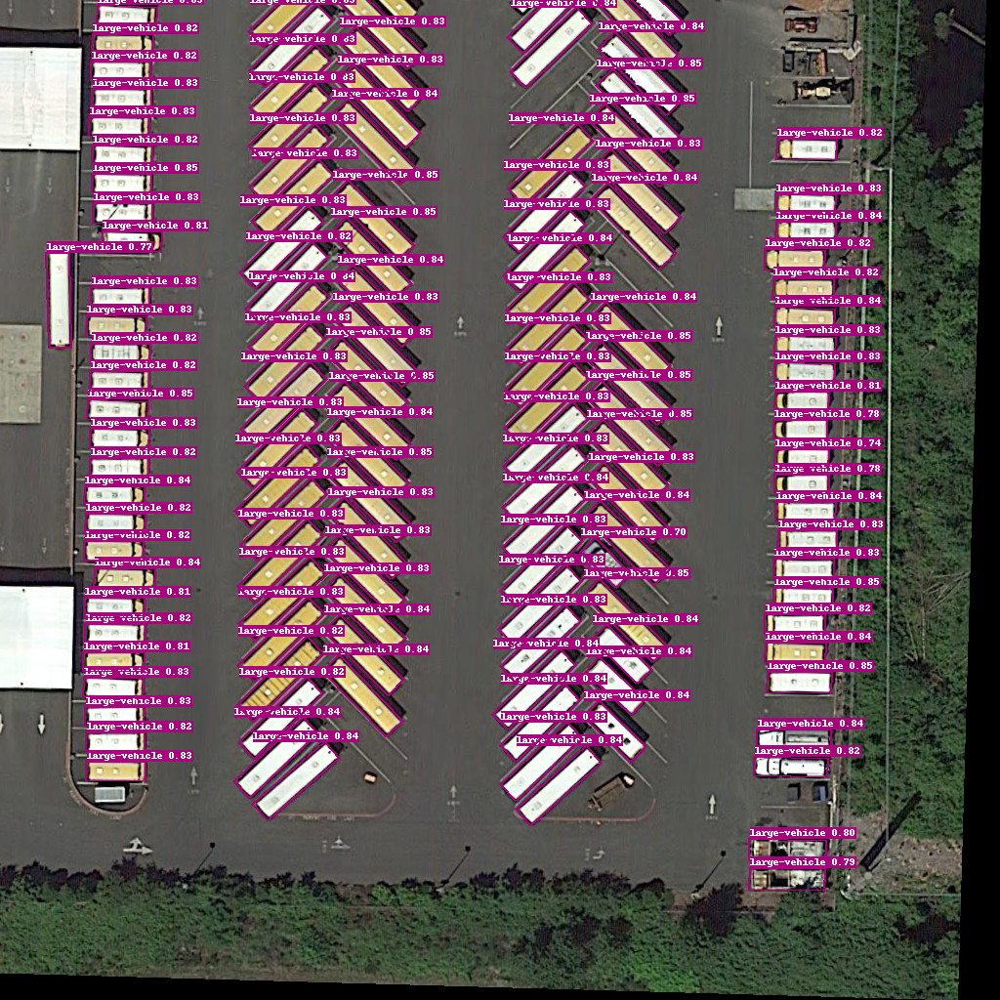
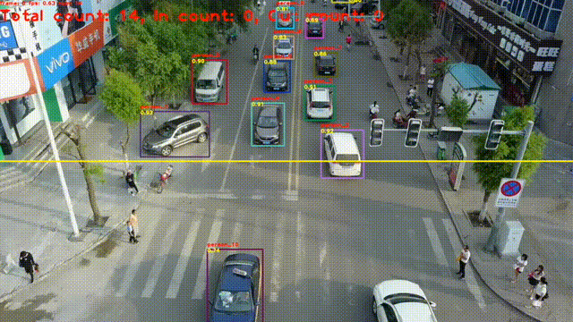
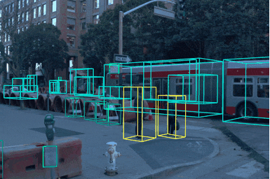
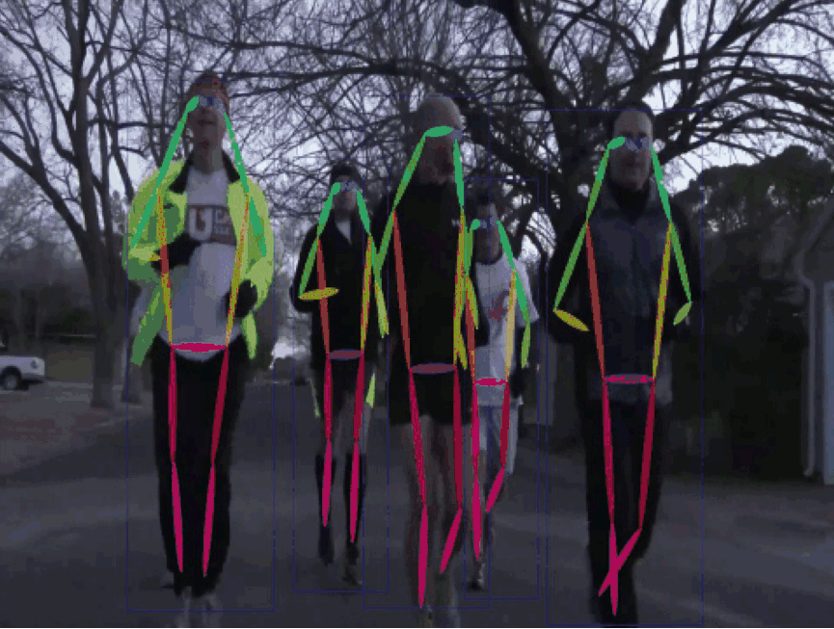
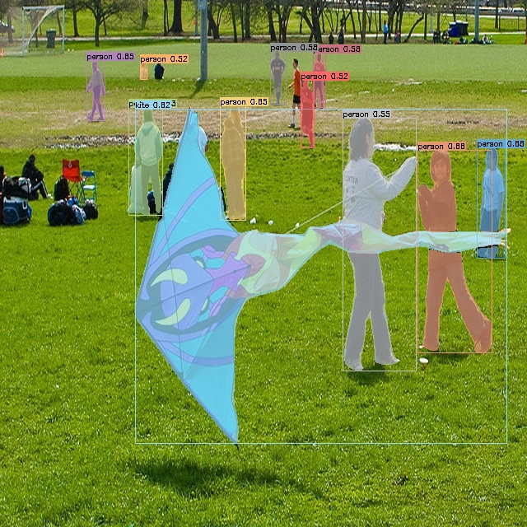
2 - Object Detection
AI VIETNAM
All-in-One Course
PaddleDetection - PaddleDetection

Slide 12
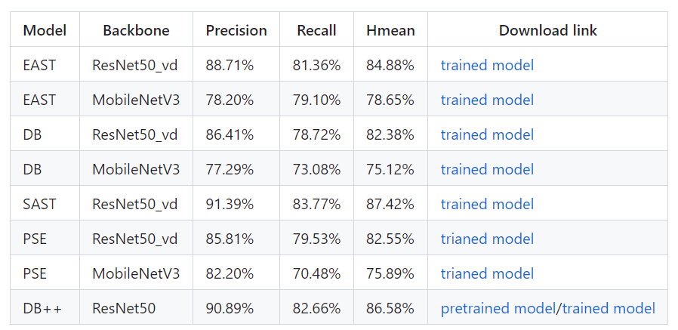
3 - Optical Character Recognition
AI VIETNAM
All-in-One Course
Text Detection

Slide 13
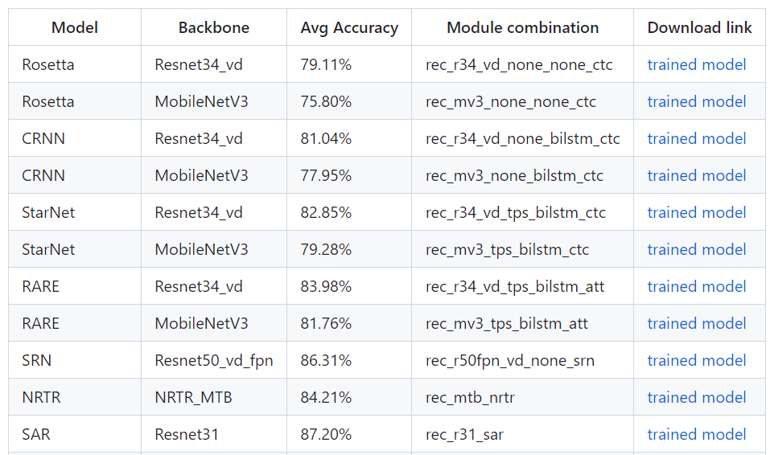
3 - Optical Character Recognition
AI VIETNAM
All-in-One Course
Text Recognition

Slide 14
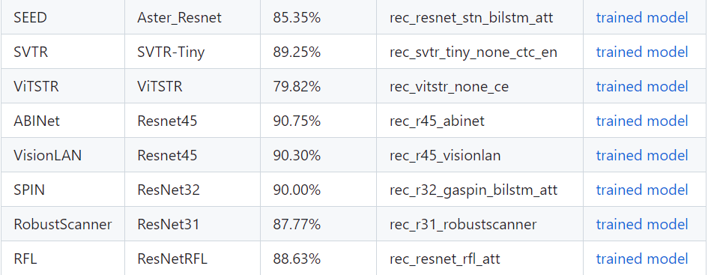
3 - Optical Character Recognition
AI VIETNAM
All-in-One Course
Text Recognition

Slide 15
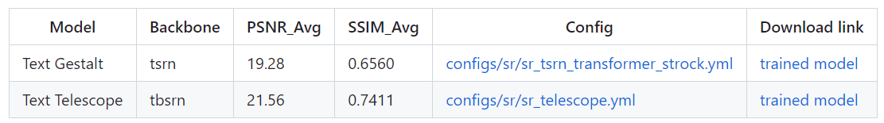
3 - Optical Character Recognition
AI VIETNAM
All-in-One Course
Text Super-Resolution Algorithms

Slide 16
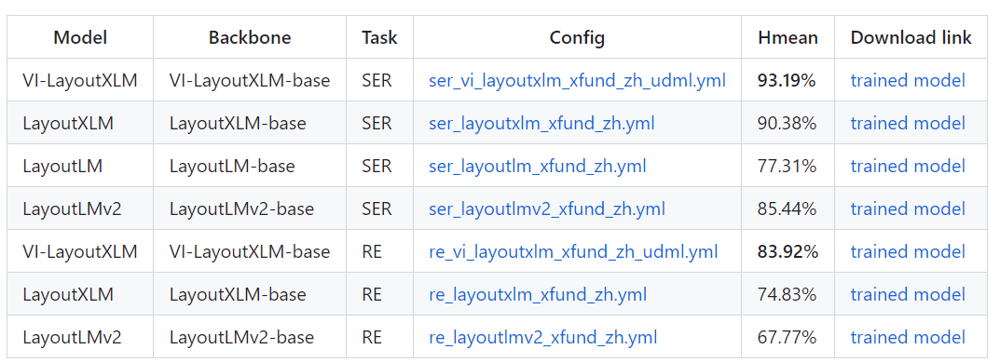
3 - Optical Character Recognition
AI VIETNAM
All-in-One Course
Key Information Extraction Algorithms

Slide 17
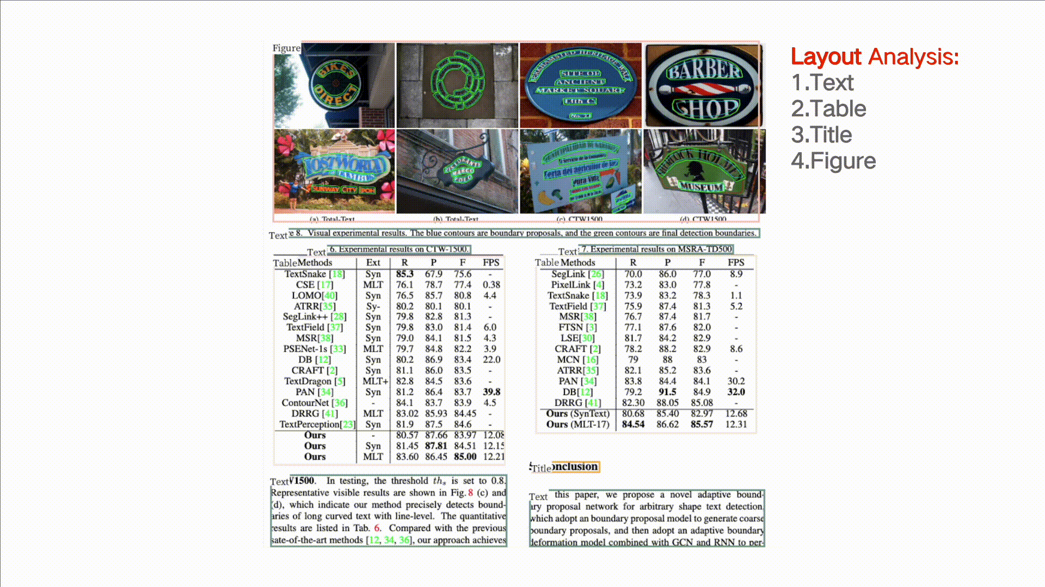
3 - Optical Character Recognition
AI VIETNAM
All-in-One Course
PaddleOCR - PaddleOCR

